Slide 1

Department of Information Technology
A.P. Shah Institute of Technology
G.B.Road,Kasarvadavli, Thane(W), Mumbai-400615
UNIVERSITY OF MUMBAI
Academic Year 2019-2020

Slide 2
A Project Report on
Web Based Student Helping System
Submitted in partial fulfillment of the degree of
Bachelor of Engineering(Sem-8)
in
INFORMATION TECHNOLOGY
By
Nilesh Yadav (16104035)
Viraj Ghag (16104024)
Amol Beldar (16104070)
Under the Guidance of
Mr.Ganesh Gourshete & Mrs.Geetanjali Kalme

Slide 3
1.Project Conception and Initiation

Slide 4
1.1 Abstract
The purpose of this project is to provide the colleges with an interactive web system for different activities going on in the colleges. The students will be able to know, ask about what all activities colleges is doing for the students. Also we can provide students to give there suggestions or requests for particular activities that the students may require on college/departmental or personal basis as well. We will be making a website for an online complaint management system where the issues of the student can be registered online and will be resolved by the college authorities. This web application can reduce the gap between the student and the college staff as all the requests, complaints suggestions etc will be confidential and only the authorised person or the person who is intended to the requests can be able to view it.

Slide 5
1.2 Objectives
The main objective behind building this project is to reduce the communication gap between the students and the college authorities and also help in creating a techno friendly environment and save time.
Students will also be able to apply/request for some important college applications/credentials as well (eg. Bonafide certificate, Concession forms etc).

Slide 6
1.3 Literature Review
Sr. No | Name of Paper | Authors | Year of publish
1 | Use of \Kiosks" as a Self Service Tools in Libraries." | Kaur, Harpreet, and Sonali Malhotra | 2018
2 | Authentication Model using the Bundled CAPTCHA OTP Instead of Traditional Password | Kansuwan, T., & Chomsiri, T | 2019
3 | A Networked Multimedia Distributed Kiosk System for Commercial and Home Appliances. | Si, Nong, Ke-Bin Jia, and Chang Xu | 2016
4 | OTPaaS —One Time Password as a Service | Erdem, E., & Sandikkaya, M. T. | 2018
5 | Lecturers’ perspective of student online feedback system | Kassim, R. A., Johari, J., Rahim, M. I., & Buniyamin, N. (2017). | 2017

Slide 7
1.4 Problem Definition
Not being able to convey the problems or avail the college provided services in a correct way may lead to degradation of the infrastructure of the college environment. If the authorities didn’t understand the problems students are facing or the extra services the students desire for their betterment the college won’t be able to progress in a right way and also with the pace they expect. So with the help of the WEB BASED STUDENT HELPDESK SYSTEM the students can convey their problems in a better and secure way to the college authorities which will be completely confidential between the sender and the receiver and thus helping the college know the students requirements and problems and helping to progress in a faster pace

Slide 8
1.5 Scope
Decrease the communication gap between students and staff.
Student’s and staff problem can be solve easily and fastly.
Service request and response transparently.
Useful in any organization for staff.

Slide 9
1.6 Technology stack
HTML5
CSS
PHP
MYSQL Database
Java Script
API Key

Slide 10
1.7 Benefits for Environment & Society
By implementing this project it would help the college to progress and develop at a faster level as all the complaints and requests which the students were not able to convey before to the faculty or staff directly can be conveyed easily in a secure & authenticated manner thus helping the college to know students requests and difficulties leading to betterment of college in its overall development.

Slide 11
2. Project Design

Slide 12
2.1 Final System
In the final system, the students will be able to convey there problem, feedback,requests to the college using the WEB BASED STUDENT HELPDESK which will be implemented in the college. The students will need to login into the system through their unique login credentials provided to them by the admin.Once the student logins into the system he/she can convey his/her problems or even request his needs to the authorities in a secure and confidential way. Thus saving time and manpower.Also this requests and complaints will be known only to the students andthe person to whom it is intended thus no one can make changes into the messages been addressed.

Slide 13
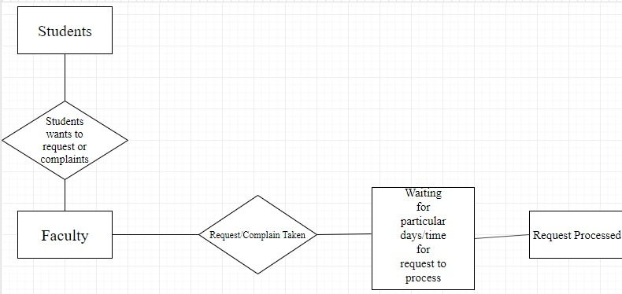
2.2 Design(Flow Of Modules)
Previous System

Slide 14
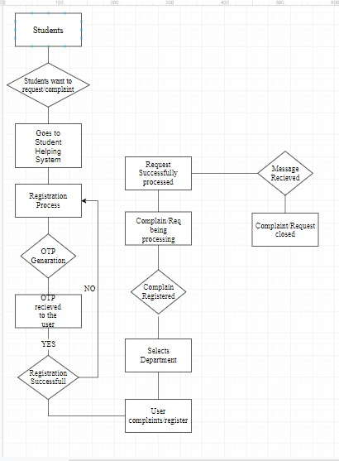
Final System

Slide 15
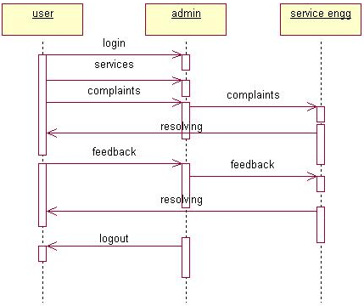
2.3 Use Case

Slide 16
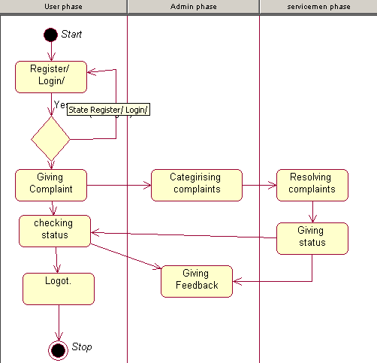
2.4 Activity diagram

Slide 17
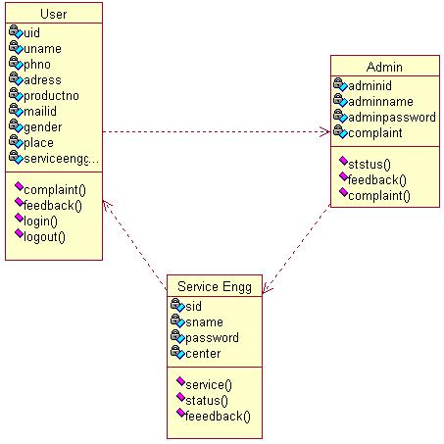
2.5 Class Diagram

Slide 18
2.6 Module-1 Admin Functions
Management of the database
Admin can manage users
Have to response for student’s complain /request /query
Update the status of complain /request /query
Admin can also upload the document for response
Forward complain /request /query to respective department
User monitoring.

Slide 19
Module-2 User Functions
Register and Login to the system
Update the profile
User can lodge complain /request /query with the uploadation of related document
Able to see the progress of complain /request/query

Slide 20
Module 3- OTP Generation
Generates a unique OTP number
Verifies the mobile number and send the OTP number.
By entering the OTP number you can login into the network as a valid user can

Slide 21
2.7 References
Kaur, Harpreet, and Sonali Malhotra. "Use of \Kiosks" as a Self Service Tools in Li-braries." 2018 5th International Symposium on Emerging Trends and Technologies in Libraries and Information Services (ETTLIS). IEEE, 2018
Kansuwan, T., Chomsiri, T. (2019). Authentication Model using the Bundled CAPTCHA OTP Instead of Traditional Password. 2019 Joint International Conference on Digital Arts, Media and Technology with ECTI Northern Section Conference on Electrical, Electronics, Computer and Telecommunications Engineering
Si, Nong, Ke-Bin Jia, and Chang Xu. "A Networked Multimedia Distributed Kiosk System for Commercial and Home Appliances." 2016 Third International Conference on Computing Measurement Control and Sensor Network (CMCSN). IEEE, 2016.
Erdem, E., & Sandikkaya, M. T. (2018). OTPaaS —One Time Password as a Service. IEEE Transactions on Information Forensics and Security.
Kassim, R. A., Johari, J., Rahim, M. I., & Buniyamin, N. (2017). Lecturers’ perspective of student online feedback system: A case study. 2017 IEEE 9th International Conference on Engineering Education (ICEED).
Srivastava, S., & Sivasankar, M. (2016). On the generation of alphanumeric one time passwords. 2016 International Conference on Inventive Computation Technologies (ICICT)

Slide 22
Thank You

